Slide 1
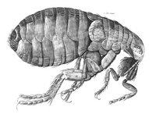
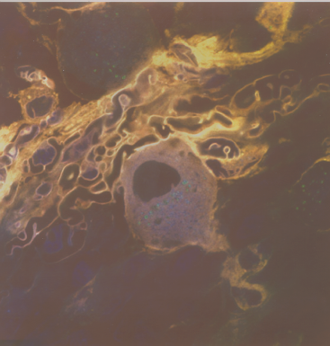
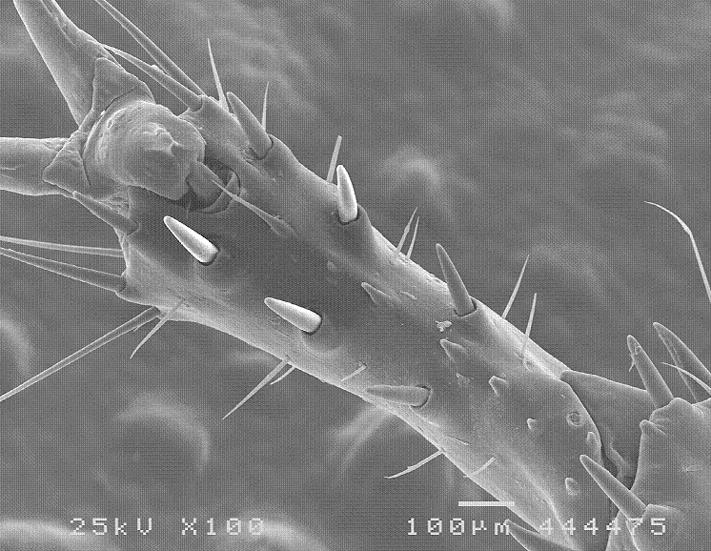
Scientific Microscopy vs. (just) counting the hairs on a flea?
Hooke from Micrographia
Our question should have a testable hypothesis attached and be shaped such that microscopic imaging can help with an answer. Controls must be included to discover imaging artifacts and clarify results.
Our goal is to ask an interesting question that we can attempt to answer by collecting image data from a sample during a reasonable amount of time.
General requirements for our research projects:
Must be something we can address with our imaging tools
Must involve a material that we have access to, best to see your faculty mentor for sample and us for preparation and imaging materials
Must have some context to be meaningful (usually in the literature) It is possible for context to be provided by your reason and imagination
must have adequate design such that we can run control and experimental trials and get results in time available (8 weeks in this case)
The flea drawing from 18th century and the scorpion leg above are examples of scientific microscopy, they were both imaged within the context of scientific inquiry. The 3 channel confocal image of frog neuron in the middle (taken by David Neff) has no scale bar and was imaged just for fun, no experiment. The message here is that counting hairs on a flea (or scorpion) can be science while imaging complex patterns of primary and secondary fluorescence can sometimes be nothing but amateur art.

Slide 2
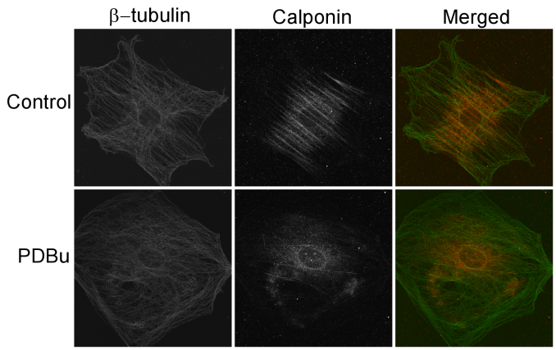
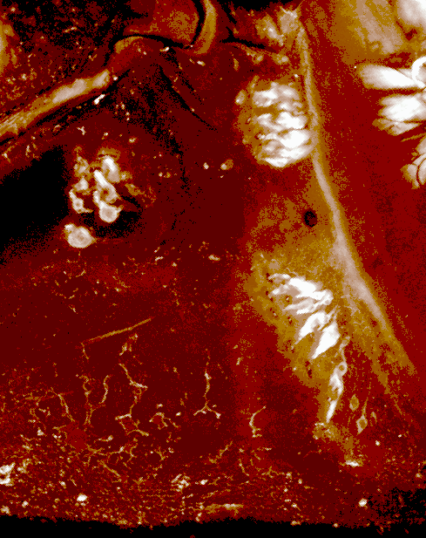
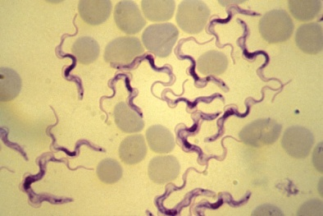
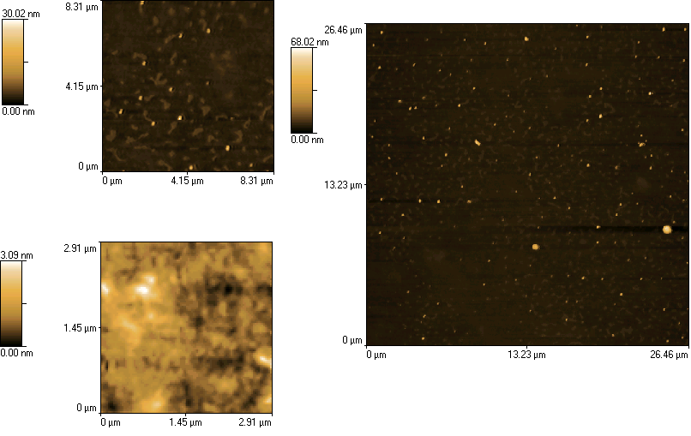
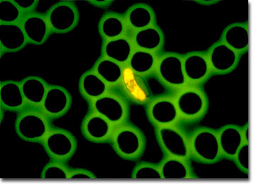
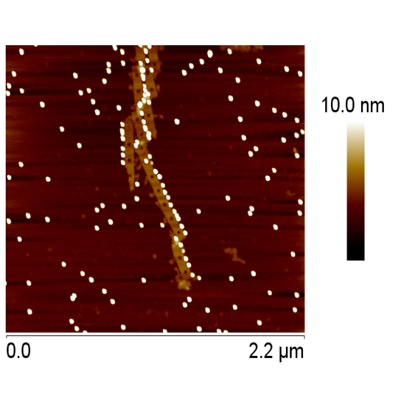
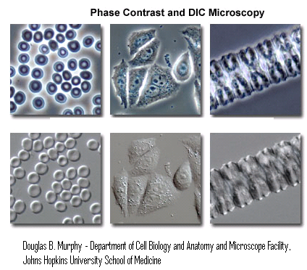
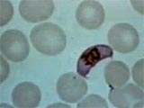
What do we need from our sample to create a microscopic image
Sample with some feature (in-homogeneity) of appropriate size to provide contrast
Trypanisome parasite
Dr Rodrigo Alves De Fonseca:
Laboratòrio de Parasitologia, Faculdade de Ciencias da Saùde -
Universidade de Brasilia, Brasilia,
http://www.olympusmicro.com/galleries/fluorescence/pages/rapiddiagnosismalariasmall.html
Malarial parasite, contrast above derives from fluorescent dye, below from standard histological stain. Red blood cells in each case are only lightly stained.
http://www.cbc.ca/gfx/photos/malaria_parasite.jpg
What sample attribute leads to the in-homogeneity in each of these images?

Slide 3
The in-homogeneity must be detectable (signal > background or noise high S/N is better)
surface topography
reflectivity /absorption
scattering (diffraction)
secondary signal (electrons, x-rays, fluorescence)
texture (friction, hardness, inter-molecular adhesion)
phase object
electronic or magnetic state, localized charge

Slide 4
Microscopy (imaging) always must involve mapping
Microscopy Can involve:
Morphology (study of shape)
Metrology (study of Cartesian (geometric) type measurments)
Crystallography (mapping molecular or crystal structure)
Tomography (slice mapping)
Spectroscopy (spectrum viewing)
Morphology (study of shape)

Slide 5
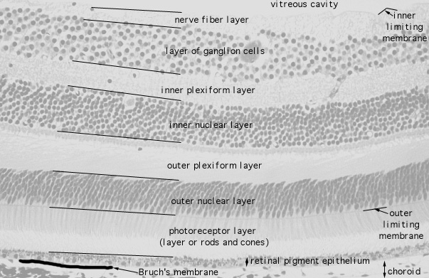
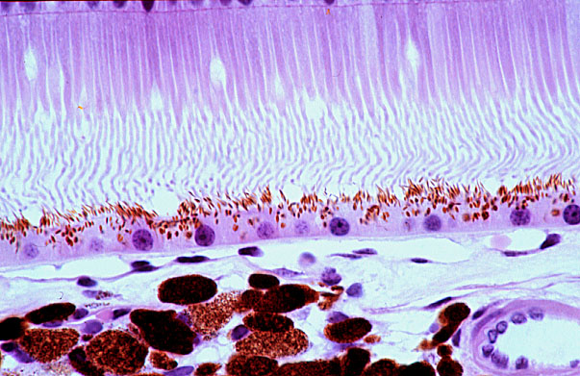
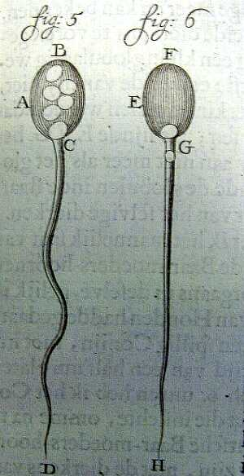
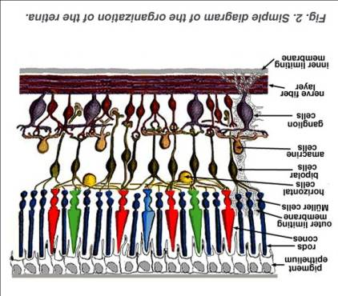
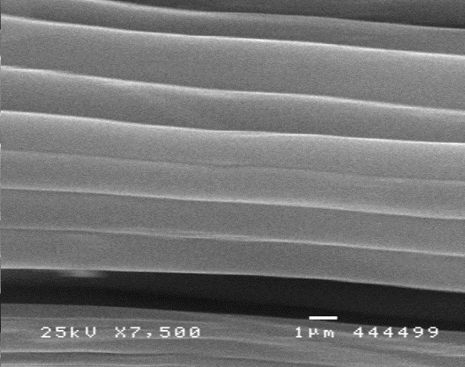
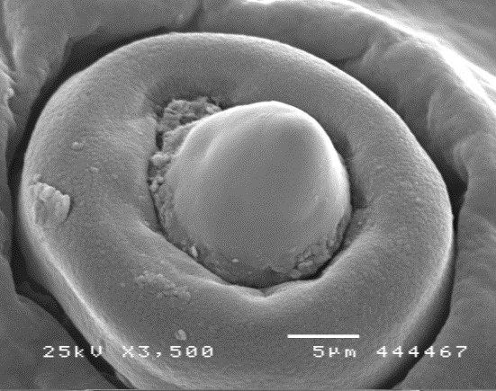
Morphology: the shape of things (scale bar can allow metrology from morphology)
Boston U med school histology of the retina
webvision.med.utah.edu
Flea drawing for Micrographia (Hooke) by Christopher Wren (18th century).
SEM of spider silk from MU.
Drawing of rabbit sperm by Leeuwenhoek’s scribe (18th century)
SEM of sensory organ from fly larva imaged at MU.

Slide 6
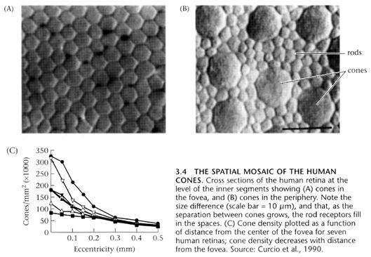
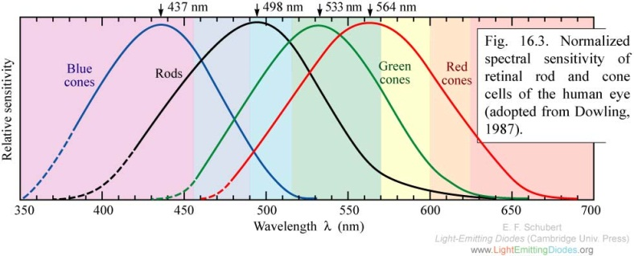
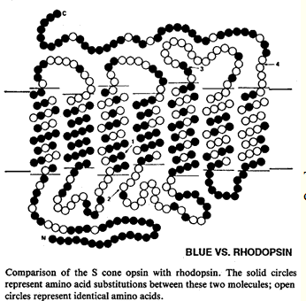
Discussions of color vision chemistry
http://hubel.med.harvard.edu/book/b41.htm
Here, in fovea of macula to right outside fovea
http://www.cis.rit.edu/people/faculty/montag/vandplite/pages/chap_9/ch9p1.html
blue/green - r
blue - c
green -c
red -c
This figure shows the sequence for the S-cone pigment compared to that of rhodopsin. The S-cone pigment gene is located on chromosome 7. Notice how different they are.
http://www.cis.rit.edu/people/faculty/montag/vandplite/pages/chap_9/ch9p1.html

Slide 7
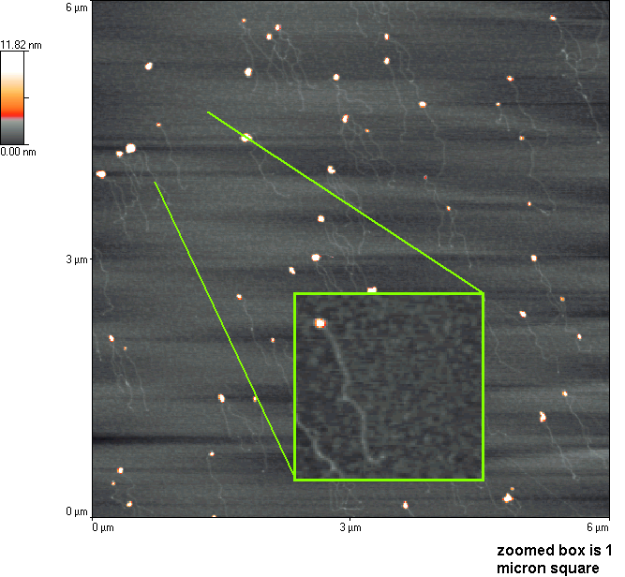
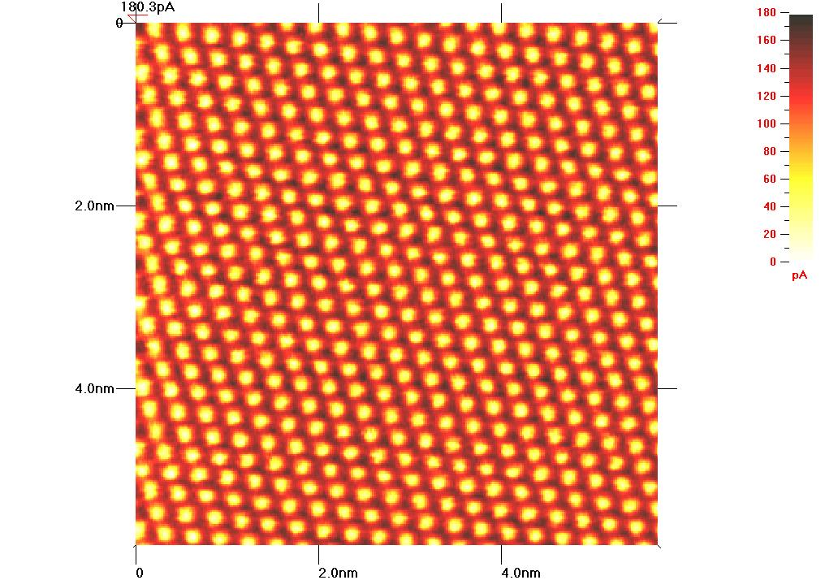
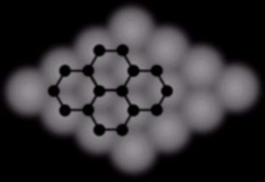
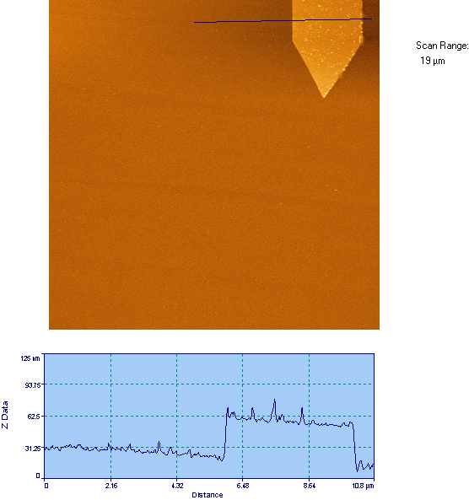
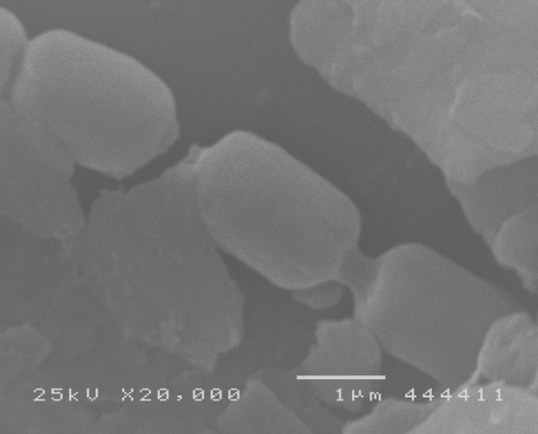
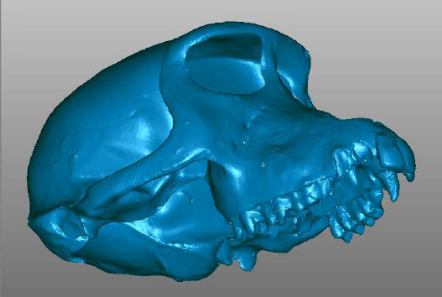
Metrology: study of Cartesian measures
IN METROLOGY, SCALE BAR IS ALL IMPORTANT
z
HOPG images from
MikroMasch
x
x&y measurements can be distorted in atomic force microscopy (AFM) by the shape of the scanning tip, z measurements are reliable (AFM of dna with qdots above)
Scanning Tunneling Micrograph of graphite seen above.
y
This (bio-film bacteria above) and most scanning electron micrographs have such depth of field that much of the object’s depth appears clearly focused . Why does this make 2D measurements in x & y tricky?
Monkey skull image from LDI
Real 3D scale must be stored with 3Dimage data, 2D scale bar cannot be used accurately. This is a surface map of a monkey skull scanned with a laser scanner (above).
This (above)and most atomic force micrographs give very accurate measurement in z. This object is much larger than the probe tip so its x/y dimensions are also accurate.

Slide 8
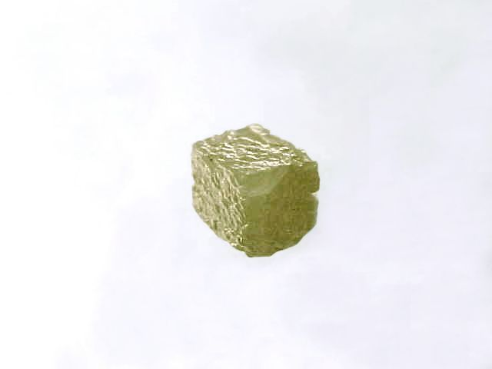
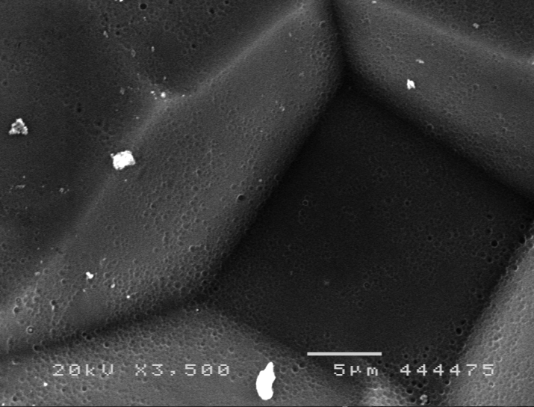
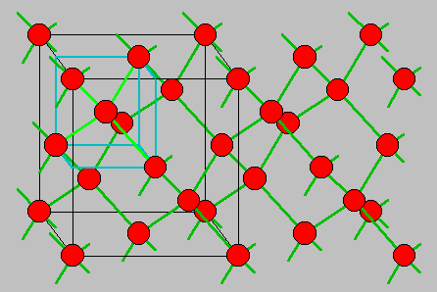
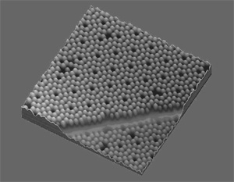
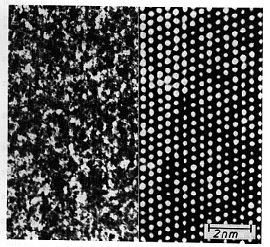
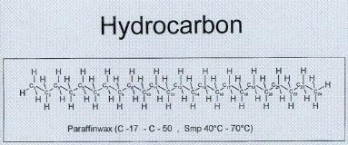
Crystalography (mapping atomic or molecular lattice in crystals)
Natural diamond crystal from Congo, .7 carats for $40
Crystal lattice of diamond, silicon and germanium.
2mm
SEM image of diamond film made at MU
STM image of Si wafer from http://www.escad-vision.de/2070_Microcracks.aspx
Ernst Ruska’s paraffin crystal in TEM
http://home.mesastate.edu

Slide 9
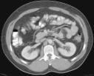
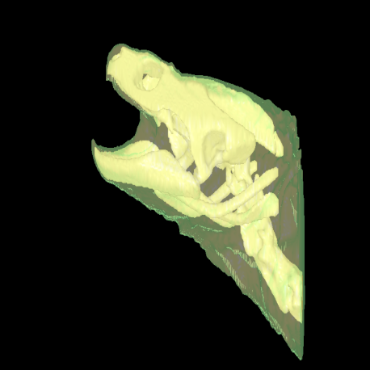
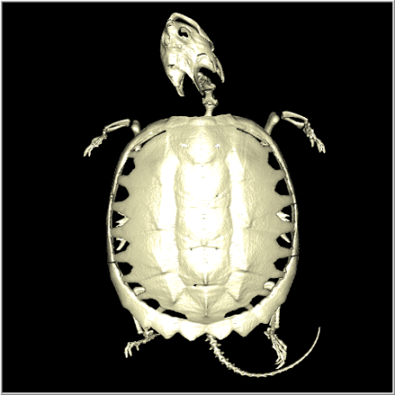
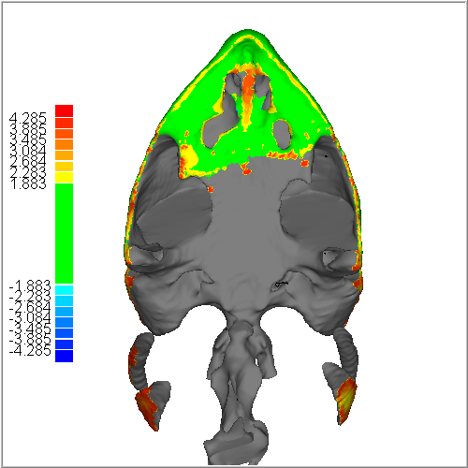
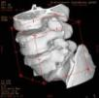
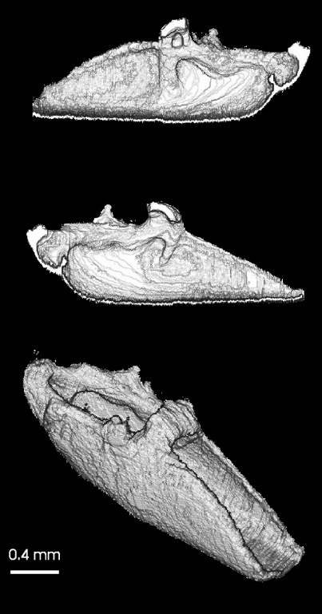

Tomography: mapping a 3D object with 2D data sets (slices)
x-ray image data can be analyzed with computer based tomography
fluorescence confocal microscope image data can be analyzed with computer based tomography
These are the original 2D confocal images that were reassembled to make the 3D model at right. Double click to see each 2D image sequentially as part of a movie.
Remember, be careful with use of this scale bar. In this case it can be used only for parts of these images.

Slide 10
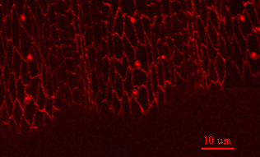
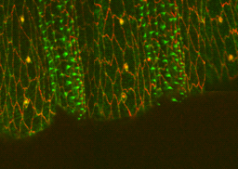
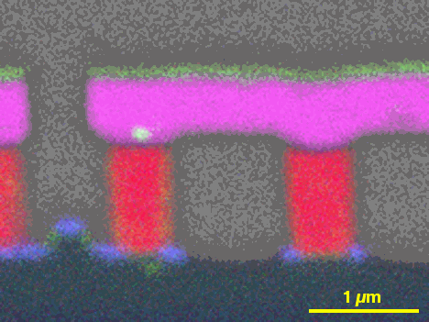
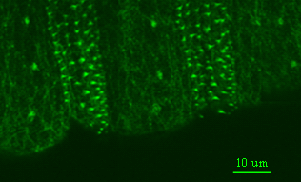
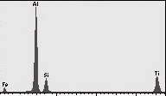
Spectroscopy
 | EDS Map SiO₂ (gray) Aluminum (magenta) Titanium Nitride (green)
Mapping multiple channels in the same object/image space
10 um
Above is 2 channel optical spectroscopy of fly larva, one channel is depicted as green the other is seen as red.
www.ornl.gov/sci/ share/msa4micro.html
counts (#xray photons)
X-ray energies as seen in the spectrum at left can be mapped to regions as seen above iron in spectrum not mapped in this image). This is the inside of an integrated circuit (computer chip)
x-ray energy (eV)

Slide 11


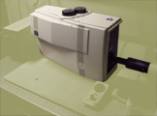
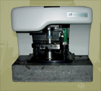
We must have a way to elicit signal from sample
Probe formation and control
detection of resulting phenomena as probe interacts with sample
the above is the job of our microscopes
OPTICAL SCOPE
AFM
CONFOCAL SCAN HEAD
SEM

Slide 12
What we have here at M.U.
SCANNING PROBE MICROSCOPES
AFM,MFM, AND NSOM
SEM WITH XRAY SPECTROSCOPY
CONFOCAL FLUORESCENCE
LASER SCANNER (SURFACE IMAGING)
TRANSMISSION MICROSCOPES
TRANSMITTED LIGHT WITH PHASE/INTERFERENCE CONTRAST AND VISIBLE LIGHT SPECTROSCOPY
STANDARD EPI-FLUORESCENCE ALSO WITH VISIBLE LIGHT SPECTROSCOPY
TEM

Slide 13
Imaging Core Instrumentation
Laser Scanning Confocal Microscope
Multiphoton Scanning Confocal Microscope
Fluorescence Microscope (single molecule)
Atomic Force Microscope
Near Field Scanning Optical Microscope [AFM/NSOM]
      Scanning Electron Microscope [Under buffer SEM]
Transmission Electron Microscope
Scanning Tunneling Microscope
https://www.marshall.edu/mbic/index.html

Slide 14
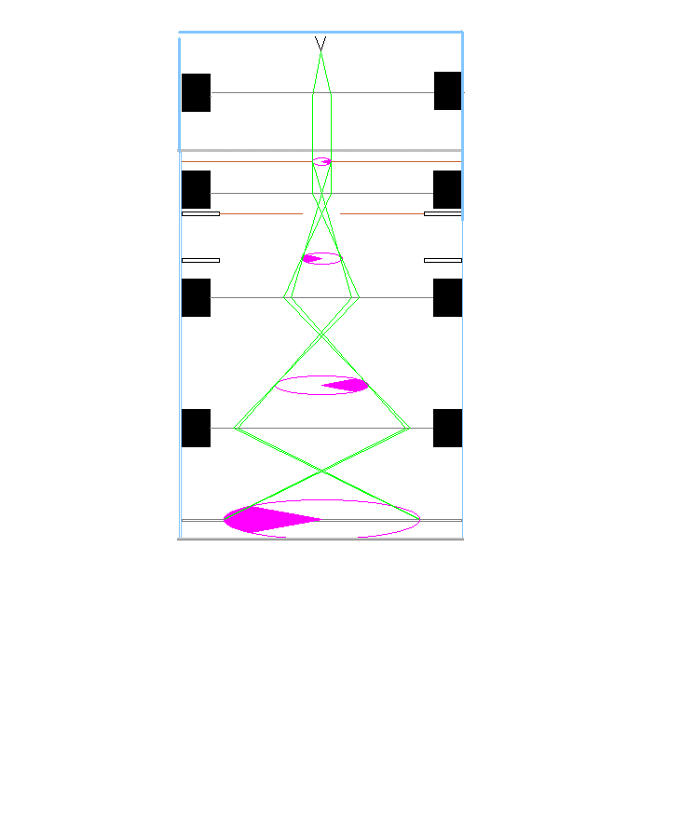
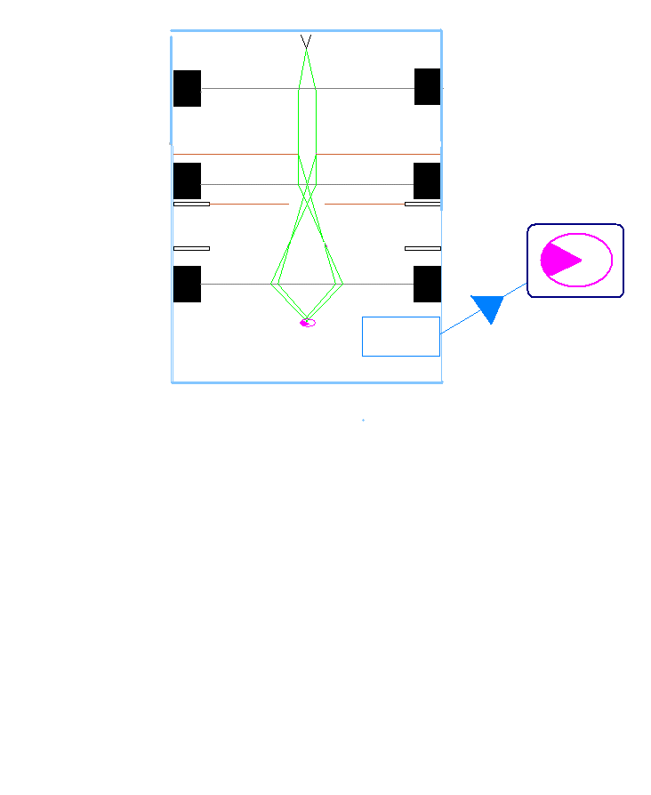
ELECTRON MICROSCOPES AS EXAMPLES OF PROJECTION VS. SCANNING IMAGING SYSTEMS
electron source
sample
electron detector
TEM
SEM
Transmission em
Scanning em
Image on electron sensitive projection screen
Image produced on TV style monitor

Slide 15
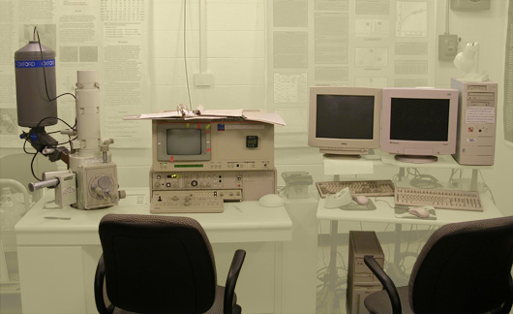
SEM

Slide 16
SEM(scanning electron microscope JEOL 5310LV )
probe type
probe control
types of samples (from where does the contrast arise?)
size of viewable field and sample size
size of details resolvable
high velocity electron beam focused to a spot and scanned across the sample
high voltage accelerates electrons to form probe, magnetic lenses scan and focus probe across sample
contrast is in variation of secondary (not beam in origin) emissions, x-rays or electrons. This in- homogeneity can arise from shadowing of detector by sample or by actual differences in amount of emission (as in atomic mass contrast)
field of view can be as large as 7mmx5mm, sample can be as large as a golf ball
the microscope has a stated resolution of ~5nm, our best efforts on highly contrasted samples have demonstrated 15nm resolution

Slide 17
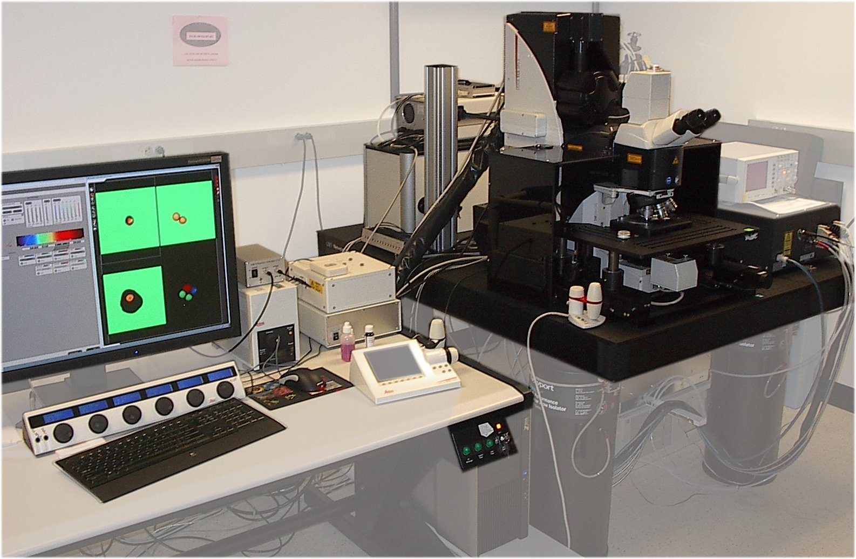
Leica SP5 TCSII Multiphoton (MP) Microscope with
Coherent Chameleon VisionII (IR) laser

Slide 18
Leica SP5 TCSII Multiphoton (MP) Microscope with Coherent Chameleon VisionII (IR) laser
TCS (true confocal scanner) SP5 (spectral imaging with up to 5 detectors)
-MP laser tunable from 680nm-1080nm - >3 Watts power at peak output
-MP laser 80MHz, femtosecond pulses enable 2P events for fluorescence imaging
-also: 405nm and 561nm diode lasers and Argon and HeNe gas lasers with multiple lines selectable (458, 476, 488, 496, 514 and 633nm)
-with 6 non-descanned detectors, 4 descanned detectors and with TLD (Transmitted Light Detector, PMT) and standard epifluorescence
-with prism/slit based, full spectrum tunable emission filtering
-with AOTF filtering allowing ROI (region of interest) specific illumination
-with resonant scanner capable of 16,000 lines per second in x/y plane.
• LAS/AF processing software enables full 3D reconstruction and analysis.
•Integrated electro-physiology software/hardware allows temporal coordination of imaging with physiological measurements.
•With the Leica SP5 microscope (in non-MP mode) and optimal pinhole, resolution is as low as 200nm in XY and 350nm in z axis
visible laser lines
2-photon

Slide 19
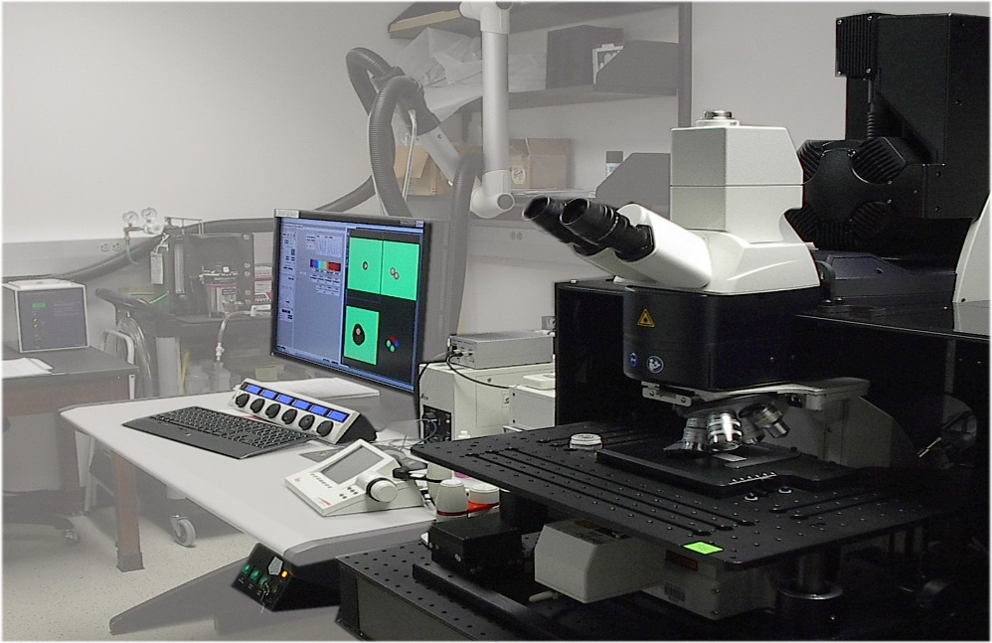

Leica SP5 TCSII Multiphoton (MP) Microscope with Coherent Chameleon VisionII (IR) laser
-Purchased in 2011 from MRI NSF funded proposal
-Has been maintained under basic service contract (MP laser and SP5) and improved with user fees and other non-MRI funding
In vivo multiphoton image of blood vessels in the plexus surrounding the tibial growth plate of a live, anesthetized 5-week-old mouse.
Maria Serrat lab

Slide 20

Mary Risher: Organotypic Slices
Astrocytes iGluSnFR (CFP-YFP) FRET Probe

Slide 21

Mary Risher:
Organotypic Slices: Astrocytes

Slide 22
CSLM (confocal scanning laser microscopy BioRad MRC1024 & Leica SP5)
coherent laser light focused to a point (spot) on the sample by the objective lens
gas lasers (KrAr or Ar) or a selection of solid state lasers emits distinct lines of UV, blue, yellow, red, infrared, etc. light. Mirrors, lenses and optical filters act to form and scan a point (spot) of light over the sample.
contrast arises from variation in reflection from sample surface (topography again) or from secondary emissions (fluorescence or phosphorescence). Reflection and some fluorescence is endogenous. We usually image secondary fluorescence, (as opposed to auto-fluorescence) phosphorescence lingers too long for most applications.
field of view ranges from 2120 um at 4x no zoom to 8um at 100x zoom10x.. For maximum resolution (most objectives), the sample must be viewed through a coverslip of 170 micron thickness. One can image the surface of any object that fits on the stage.
the microscope has a theoretical xy resolution of dxy =(.61 λ) / NA(objective only). About 200-300nm for high NA objective. Z resolution is based on iris size, with optimum confocal iris size: dz = 2λ η / NA² about half the resolution as lateral (600nm).
probe type
probe control
types of samples (from where does the contrast arise?)
size of viewable field
size of details resolvable

Slide 23


Atomic Force Microscopy
Bruker FastScan Bio. is our newest AFM

Slide 24



AFM NSOM
NSOM
Images of cultured fibroblast cells
on glass coverslip (7 micron scale bar)
NSOM, Nanonics

Slide 25


AFM image of cultured rat arterial smooth muscle cell on glass coverslip
(50 micron field)
Explorer by Thermomicrocopes

Slide 26



AFM capabilities
Developing New Capabilities:
    Software/Hardware Requirements: User Driven
    High Speed AFM/Fluorescence in development
Bruker MM8
Norton lab
Quad + Thrombin
Quad + Thrombin + Streptavidin

Slide 27
AFM (atomic force microscopy Pacific Nanotechnology NanoR)
Probe is an ultrasharp physical object (like a needle). Our probes are usually made of silicon and are fabricated using photo-lithographic techniques. A good (new) tip is very sharp.
Probe tip is scanned across the sample surface, standard afm cannot image light but can measure a number of physical parameters. Tip is kept at sample surface (just above) with rapid feedback loop. We’re not just dragging the tip along.
Contrast arises from variation in topography, electronic or magnetic variability, different material properties (hardness, resilience, etc.) at sample surface. We use different imaging tips for different types of contrast on the sample. Surface imaging only!
Field of view is quite restrictive. 100 microns is the maximum field that we can image in one scan. The object can be much larger than this but must be moved under tip by other means. Object must also be <8um in z.
SPM have imaged single atoms with resolution of 0.1 Å, this is shorter than typical bond lengths within molecules
probe type
probe control
types of samples (from where does the contrast arise?)
size of viewable field
size of details resolvable

